Slide 1











EBM-NLP LLM TUTORIAL
Joshua Ludolf
AI 380H - AI in Healthcare
University of Texas at Austin
Notes:
Welcome, everyone! I'm Joshua Ludolf, and it's a pleasure to have you here for our EBM-NLP LLM Tutorial, part of AI 380H at the University of Texas at Austin.
Today, we're diving into the exciting intersection of AI and healthcare. We'll explore how large language models can be applied to the EBM-NLP dataset. This tutorial is designed to be valuable for both beginners and seasoned users. It's all about making complex data analysis accessible to everyone.
We'll cover a variety of topics, so whether you're here to refine your skills or start a new analytical journey, there's something in it for you.
Let's get started with a brief overview of what we'll cover in the upcoming slides.
Link to google colab notebook: https://colab.research.google.com/drive/1drL2K-hdKhxq3ZciHfqBEzgbbr1RdZtL?usp=sharing

Slide 2


Overview
01
02
INTRODUCTION
DATA PREPARATION
03
04
LLM INSTALLATION
CHAIN OF THOUGHT
05
06
TREE OF THOUGHT
EVALUATION
Notes:
Starting with the overview to set the stage for what’s to come. Let's walk through the main components that we'll be exploring together.
First, we'll begin with an Introduction to the key concepts and objectives of our session. This will lay the groundwork for those new to the topic while also providing context for our more experienced attendees.
Next, we'll dive into Data Preparation. Here, we'll discuss how to clean and organize our data, ensuring it's ready for analysis. This step is crucial for accurate results and reliable conclusions.
Following that, we'll cover LLM Installation, guiding you through setting up the necessary tools and libraries to work with large language models effectively.
Then, we’ll explore two powerful techniques: Chain of Thought and Tree of Thought. These methods will enhance your ability to build prompts and process information creatively.
Finally, we'll discuss Evaluation techniques to measure the effectiveness of our models and ensure they meet our needs.
So, let's get started and enjoy the process of learning and discovery together!

Slide 3

INTRODUCTION
In this tutorial, we delve into the fascinating world of data analysis and machine learning on the EBM-NLP dataset. Designed for both beginners and experienced users, this tutorial provides a comprehensive guide on how to harness Python's powerful libraries (e.g: Ollama) to manipulate data that was textbased for Large Language Model. By exploring step-by-step examples and practical exercises, users will gain hands-on experience in building prompts using: chain of thought and tree of thought; and drawing meaningful insights from data. Whether you're looking to enhance your skills or embark on a new analytical journey, this tutorial serves as an essential resource for mastering data-driven decision-making.
Notes:
Welcome, everyone, to this tutorial on data analysis and machine learning using the EBM-NLP dataset.
This session is designed for both beginners and those with some experience, so there's something here for everyone. We'll guide you through the process of harnessing powerful Python libraries, like Ollama, to manipulate text-based data specifically for Large Language Models.
We'll explore step-by-step examples and practical exercises. You'll see how to build prompts using techniques like the "chain of thought" and "tree of thought." By the end of this tutorial, you'll have hands-on experience in drawing meaningful insights from data.
Whether you're looking to refine your current skills or start an exciting new analytical journey, this tutorial is a vital resource for mastering data-driven decision-making.
The dataset can be accessed at the following link: [EBM-NLP GitHub Repository](https://github.com/bepnye/EBM-NLP/tree/master).
Furthermore, the README.md file within the repository contains comprehensive information regarding the data's structure and labeling.

Slide 4
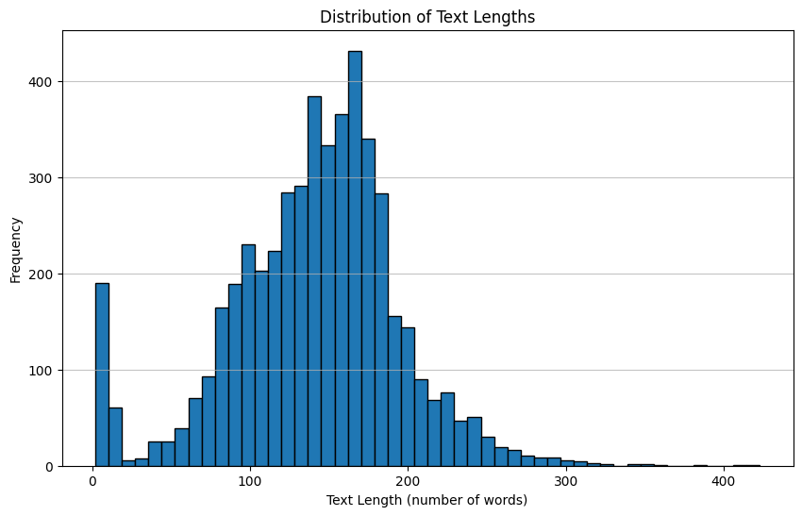
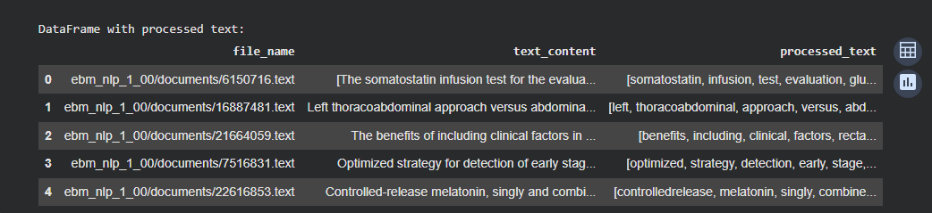
DATA PREPARATION
Steps we followed to prep the data:
Drop duplicates and empty rows.
Normalize text (lowercase, trim, remove links, emojis, and punctuation).
Tokenize, remove stop words, and lemmatize.
Keep a tidy table with original and processed text.
TOTAL NUMBER OF WORDS: 703218
AVERAGE TEXT LENGTH:
140.84
Notes:
Let's delve into the essential steps we took to prepare our data for analysis. First, we ensured the data was clean by removing any duplicates and empty rows. This helps in maintaining data integrity.
Next, we normalized the text. This included converting all text to lowercase, trimming unnecessary spaces, and removing links, emojis, and punctuation. These steps are crucial for ensuring consistency, especially when processing text data.
Following that, we tokenized the text and removed stop words. This process breaks down the text into individual words or tokens, with stop words being common words that don't add much meaning like “and” or “the.”
Finally, we lemmatized the text, which involves reducing words to their base or root form. This allows for more accurate analysis, as it groups different forms of a word together.
Throughout this process, we maintained a tidy table that kept both the original and processed text, providing a clear view of the transformation. This meticulous preparation sets a solid foundation for meaningful analysis.
We ended up with a total of 703,218 words, and the average text length is approximately 140.84. This gives us a substantial dataset to work with, enabling us to draw reliable insights.

Slide 5

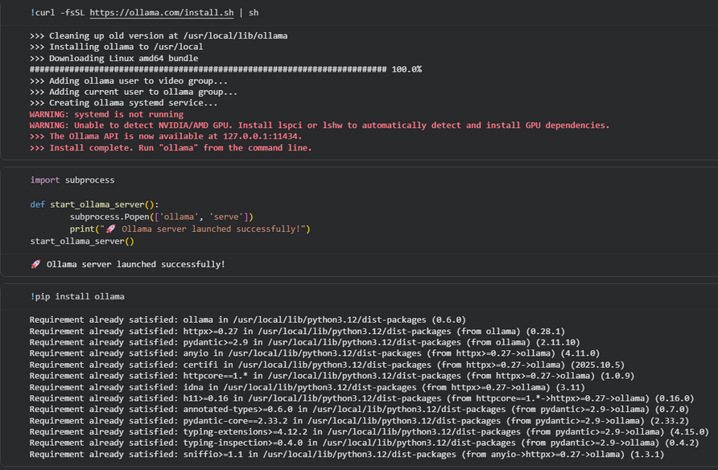

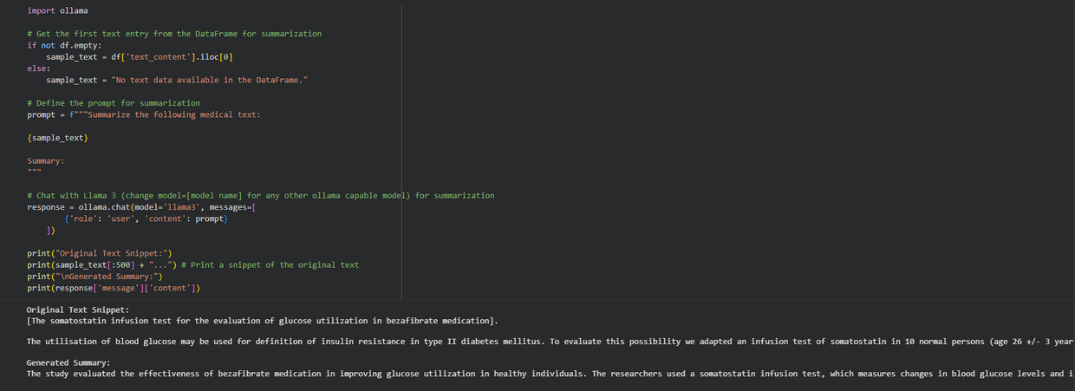
LLM INSTALLATION
OLLAMA
LLAMA3
Meta Llama 3, crafted by Meta Inc., represents a cutting-edge model series available with both 8 billion and 70 billion parameters, offering pre-trained or instruction-tuned versions. The Llama 3 instruction-tuned models are specifically fine-tuned and optimized for dialogue and chat applications, surpassing many open-source chat models in performance on standard benchmarks.
Notes:
Meta Llama 3 stands out as a state-of-the-art model series, offering choices of 8 billion or 70 billion parameters. It is available in both pre-trained and instruction-tuned versions, making it adaptable for a variety of uses, especially in dialogue and chat.
The instruction-tuned versions are specifically optimized for chat applications, outperforming numerous open-source models when assessed against standard benchmarks. As a result, users can look forward to more natural and effective interactions.
Now, let’s take a moment to mention Ollama, another Python library that we will delve into further during our practical exercises as it will allow us to use llama3 model that will run locally in the google colab notebook (see code snippets).

Slide 6
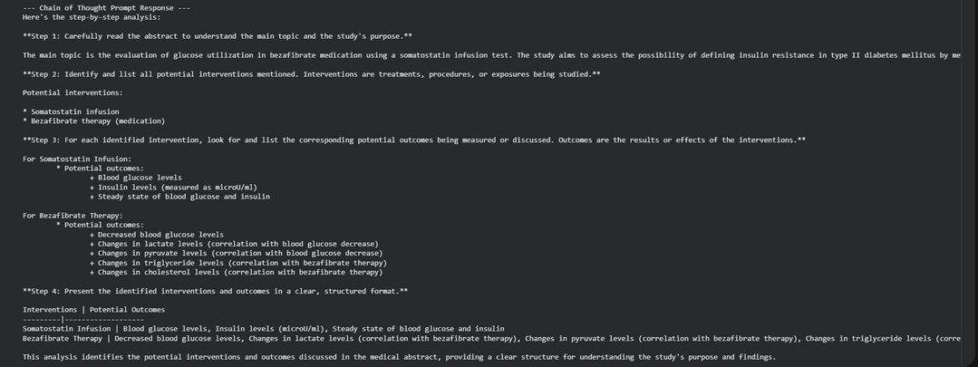
CHAIN OF THOUGHT
The Chain of Thought (CoT) prompting was established by designing prompts that clearly directed the Llama3 model to adhere to a four-step reasoning process:
reading the abstract,
identifying interventions,
identifying outcomes, presenting the results.
Notes:
This process is crucial for enhancing the model's reasoning capabilities and involves a four-step approach.
Firstly, we guide the model to read the abstract thoroughly. This step ensures a comprehensive understanding of the context.
Next, the model identifies interventions. This step is essential as it pinpoints the key actions or variables under consideration.
Moving on, the focus shifts to identifying outcomes, giving us a clear picture of the results or effects of those interventions.
Finally, the model presents the results, synthesizing all the information gathered in the previous steps into a coherent conclusion.
By following this structured process, we enhance the model's ability to perform complex reasoning tasks, making it an invaluable tool in dialogue and chat applications.
Additionally, in the google colab notebook we further refine our method to specifically extract interventions and outcomes. We had better luck after refinement as we get two key interventions and six out of seven outcomes, showing good agreement with the ground truth on this sample.

Slide 7

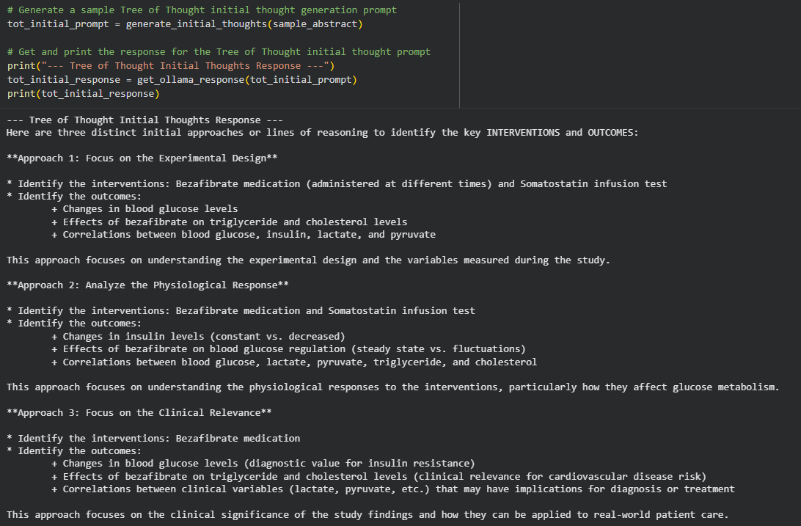
TREE OF THOUGHT
A CONCEPTUAL TREE OF THOUGHTS (TOT) PROCESS WAS OUTLINED, INVOLVING GENERATING MULTIPLE INITIAL THOUGHTS, EVALUATING INTERMEDIATE THOUGHTS, AND SELECTING PROMISING PATHS, ALTHOUGH A FULL ITERATIVE IMPLEMENTATION WAS NOT PERFORMED DUE TO COMPLEXITY.
Notes:
Now, let's delve into the Tree of Thought, or ToT, process. This method involves a fascinating approach to problem-solving.
The Tree of Thought process is about generating multiple initial thoughts. Think of it as planting seeds of ideas. From there, we evaluate these intermediate thoughts to see which ones have the most potential. It's like nurturing those seedlings to see which grow the strongest.
Although a full implementation of this iterative process wasn't done due to its complexity, the concept itself is quite powerful. It encourages exploring various paths before selecting the most promising one.
This approach can lead to more creative and effective solutions, as it doesn't limit us to a single line of thinking. Instead, it opens up a whole tree of possibilities.
As we will see in this next part that this will be the best prompting we will use in this tutorial.

Slide 8
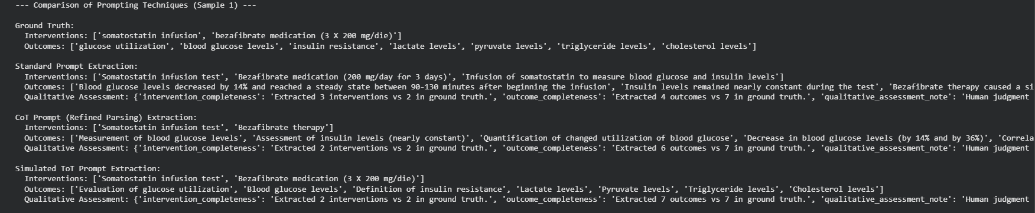
EVALUATION
ON THE SINGLE SAMPLE ANALYZED AFTER REFINING THE CHAIN OF THOUGHT PARSING:
The Standard prompt extracted the correct number of interventions but over-extracted outcomes, including extraneous details.
The refined CoT parsing successfully extracted the two key interventions and six out of seven outcomes, showing good agreement with the grOUND TRUTH ON THIS SAMPLE.
THE SIMULATED TOT OUTPUT PERFECTLY MATCHED THE GROUND TRUTH FOR BOTH THE NUMBER AND PHRASING OF INTERVENTIONS AND OUTCOMES ON THIS SAMPLE, INDICATING THE POTENTIAL OF THIS APPROACH FOR HIGH ACCURACY.
Notes:
Let's dive into our evaluation findings.
Firstly, on the single sample analyzed after refining our Chain of Thought parsing: the Standard prompt did a decent job, it correctly identified the number of interventions. However, it fell short by over-extracting outcomes. This means it included some extraneous details that weren't necessary.
In contrast, the refined Chain of Thought parsing was more precise. It successfully extracted the two key interventions and identified six out of the seven outcomes. This shows a strong agreement with the ground truth, which is quite promising.
Now, the simulated Tree of Thought output is where things get exciting. It perfectly matched the ground truth in both number and phrasing of interventions and outcomes. This suggests that the Tree of Thought approach holds significant potential for achieving high accuracy.

Slide 9




Thank You

